Slide 1
Monte Carlo Methods for Linear Systems
Tom Evans
MIT Seminar, Sept. 30, 2013

Slide 2
Acknowledgements
This work was preliminary investigations that motivated the DOE ASCR Project, MCREX: Using Monte Carlo algorithms to achieve resiliency and performance at scale for linear and non-linear solver applications
Tom Evans, ORNL (PI); Michele Benzi, Emory (Co-PI)
Steven Hamilton, ORNL; Stuart Slattery, ORNL; Wayne Joubert, ORNL; Christian Engelmann, ORNL
Much of the work presented in this talk was performed by Stuart Slattery as part of his PhD dissertation: Parallel Monte Carlo Synthetic Acceleration Methods for Discrete Transport Problems, Univ. Wisconsin, 2013

Slide 3
Outline
Motivation
Monte Carlo Linear Solvers
Monte Carlo Synthetic Acceleration
Linearized Radiation Diffusion Model
Reactor Problems using SP_{N}
Parallelization of MCSA
Conclusions and future work

Slide 4
Motivation
The next generation of computational science applications will require numerical solvers that are capable of high performance on proposed HPC platforms.
In order to meet this goal solvers must be resilient to soft and hard system failures, provide high concurrency on heterogeneous hardware configurations, and retain numerical accuracy and efficiency.
In light of these requirements, a natural avenue of inquiry would be to adapt the current stable of numerically efficient solvers to this new high-performance computing regime.
However, an alternative approach would be to investigate different classes of algorithms that can address issues of resiliency, particularly fault tolerance and hard processor failures, naturally.
Monte Carlo methods have the potential to realize this goal
Soft errors appear as high-variance events
Hard errors (node failure) can be addressed by discarding those tally contributions

Slide 5
Monte Carlo Linear Solvers
Monte Carlo methods for solving linear systems have been around a long time (Hammersley and Handscomb, 1964).
Slow and noisy
These methods are actually credited to von Neumann and Ulam
Halton’s (1962-1994) Sequential Monte Carlo is a residual technique that is far more efficient (exponential convergence).
This work has not made significant impacts in the computational transport (or broader numerical) community.

Slide 6
Establishing Notation
The linear matrix system,
Define the iteration matrix,
Leads to the Neumann Series.

Slide 7
Convergence
The Neumann Series will converge given
This implies the following iterative solution
which is also known as Richardson, or fixed-point, iteration.

Slide 8
Monte Carlo Solutions of Linear Systems
Random walks can simulate the terms in the Neumann series.
There are two approaches:
Direct methods
Adjoint methods
Direct methods estimate each component of x from a random walk.
Adjoint methods estimate all components of x from a random walk.

Slide 9
Monte Carlo Direct Method
The direct method estimates each component of the vector from a random walk
The sampled value of X from a single random walk with k events is

Slide 10
Monte Carlo Direct Method
The expected value of X is
This expectation value is a series statement of the Neumann-Ulam decomposition:
where

Slide 11
Implementation of the Direct Method
The probability matrix, P, defines the PDF for selecting a new state j for a current state i
Following the Neumann-Ulam decomposition, the transition weights from
Termination is done by augmenting the system with a terminating state or by weight cutoff:
generally, weight cutoff is chosen
augmentation is similar to analog absorption (probability of transitioning from state i to a null state)

Slide 12
Monte Carlo Adjoint Method
Sample all components of x in a single random walk.
The Neumann-Ulam decomposition is
The probabilities are defined from the transpose of the iteration matrix
Correspondingly, weight change from state i → j is

Slide 13
Adjoint Method, cont
The estimator for this method is,
is the sampled source in state i₀. Only tally in state where random walk resides.
In this sense, the adjoint method is equivalent to forward Monte Carlo transport methods.

Slide 14
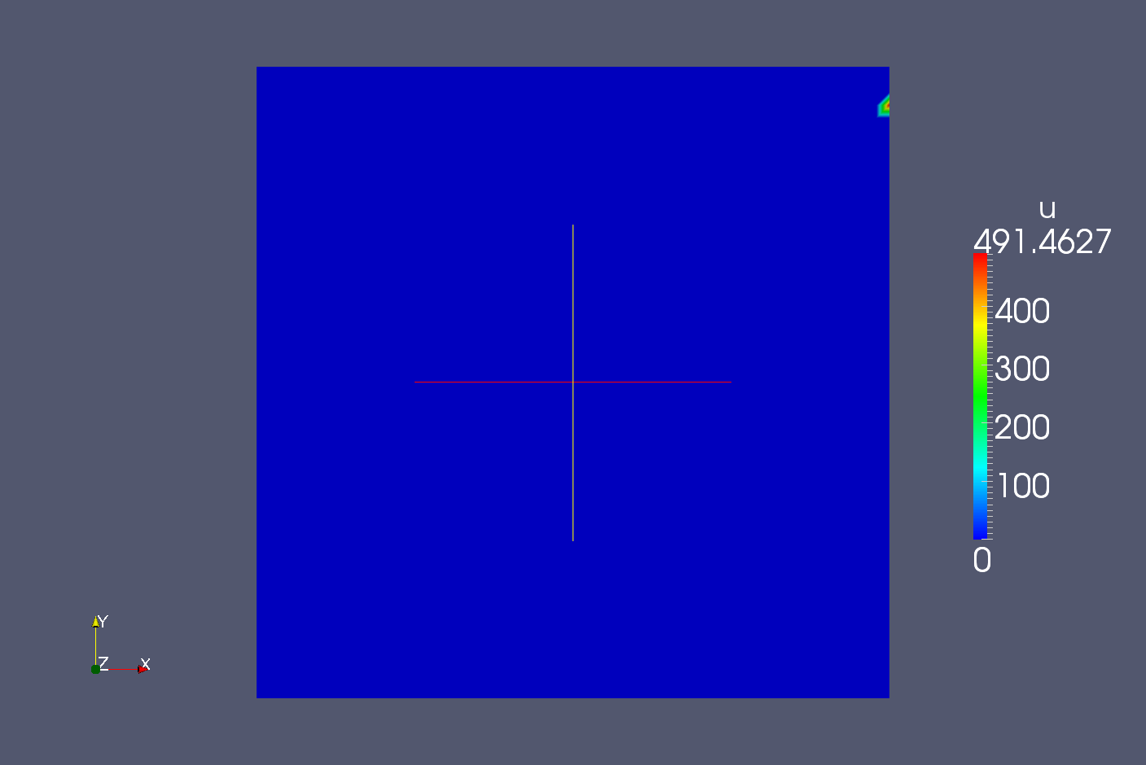
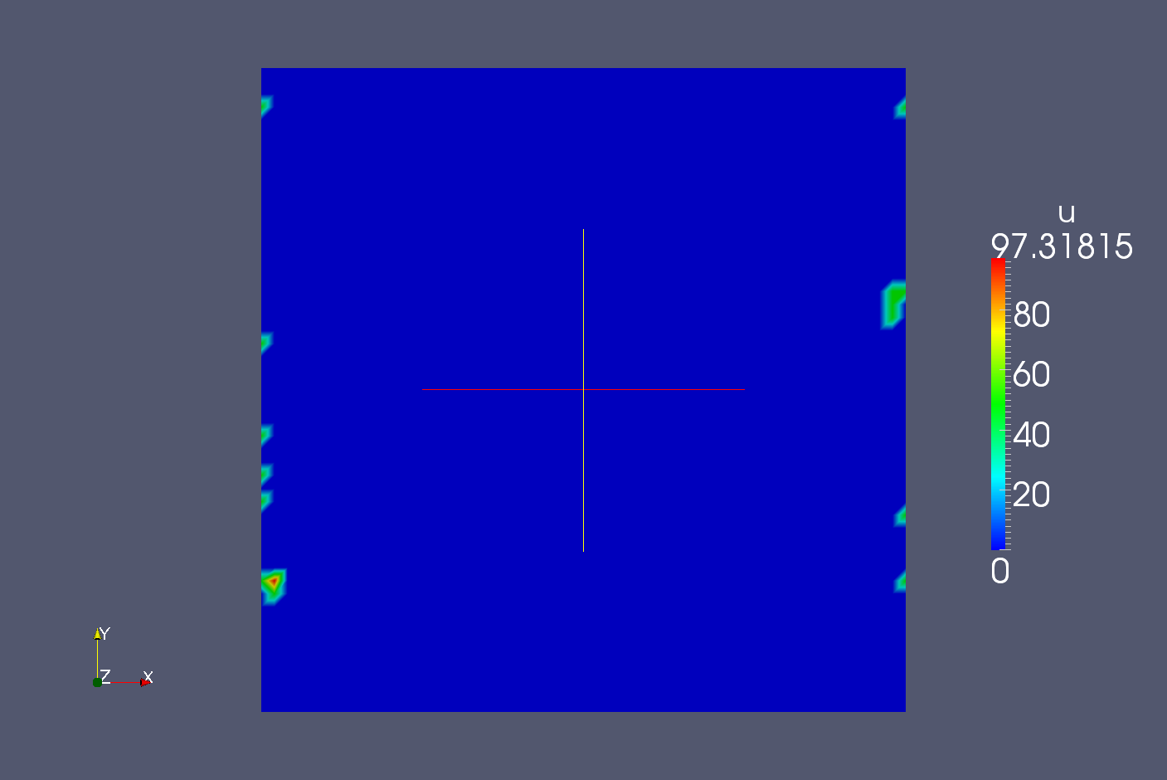
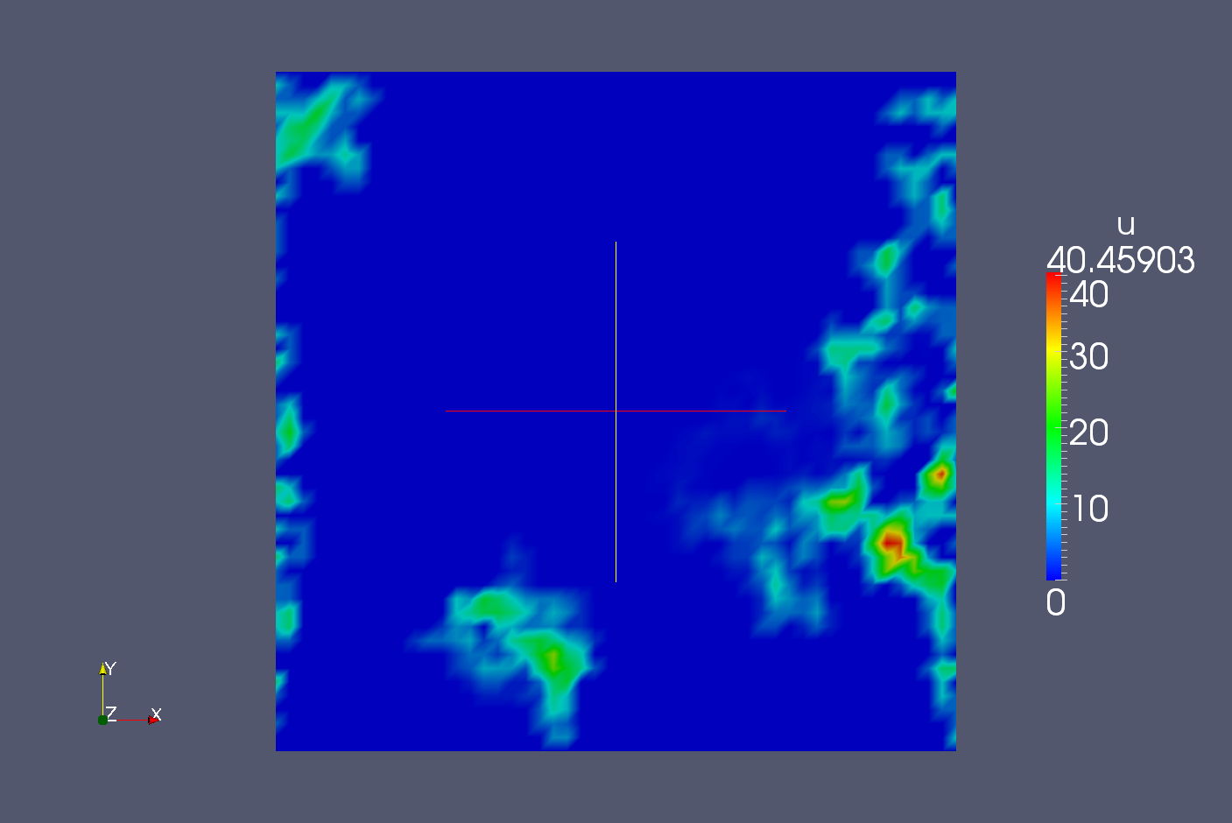
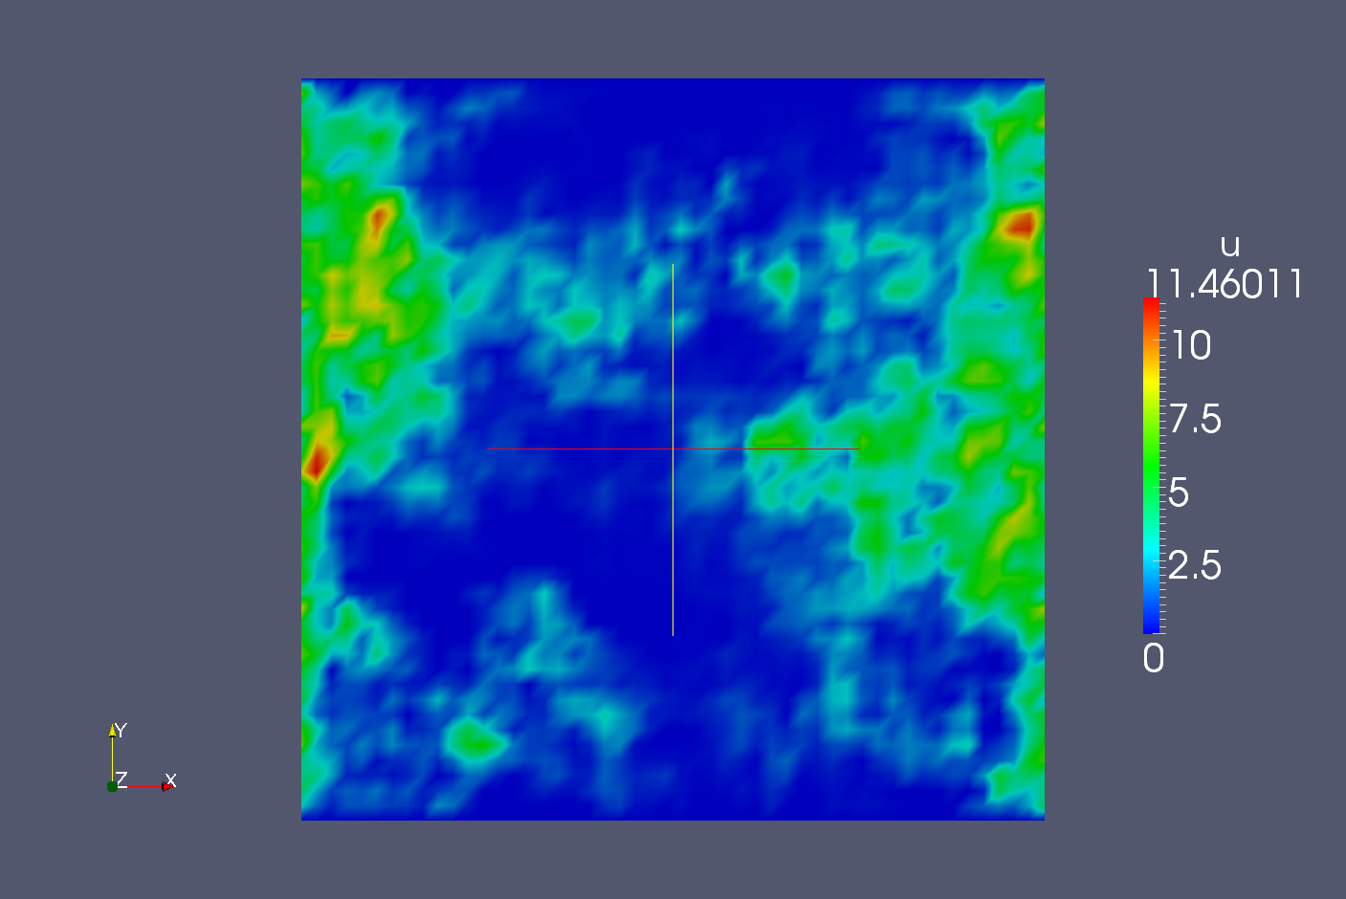
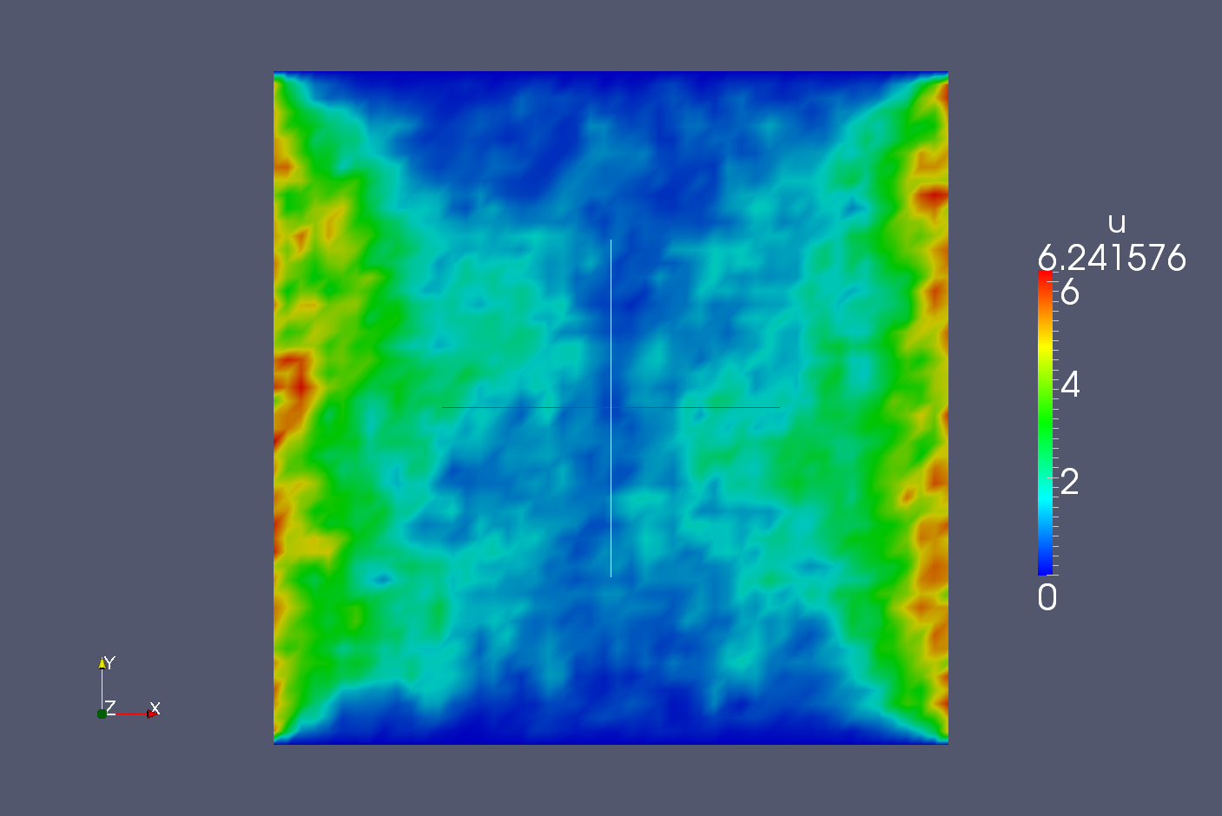
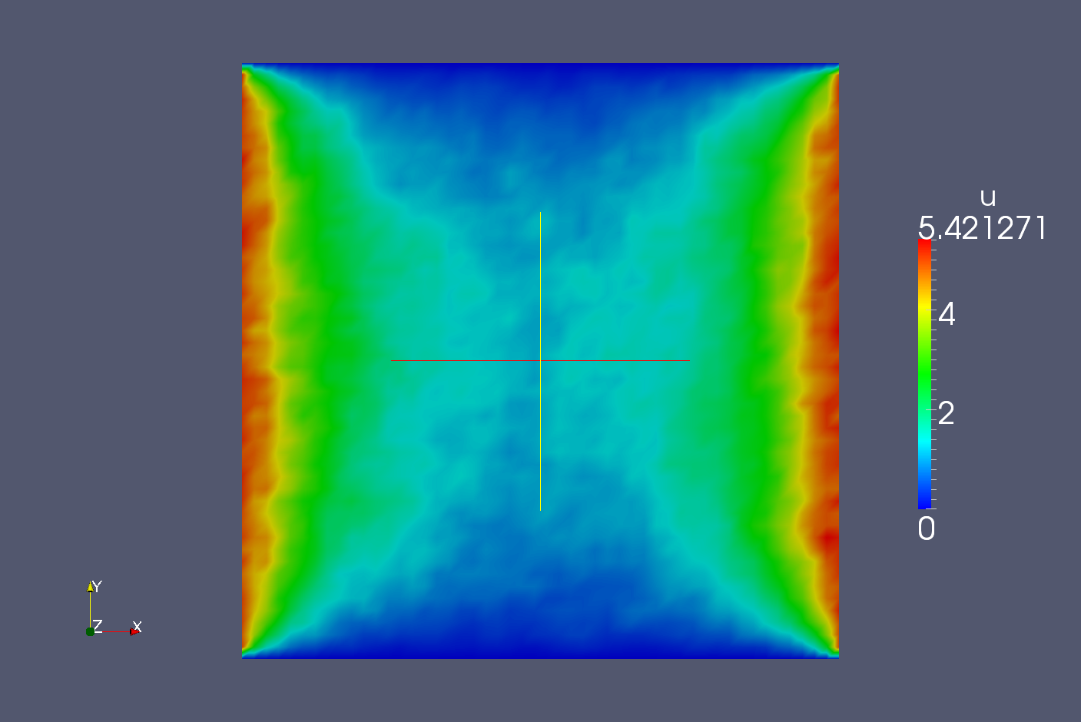
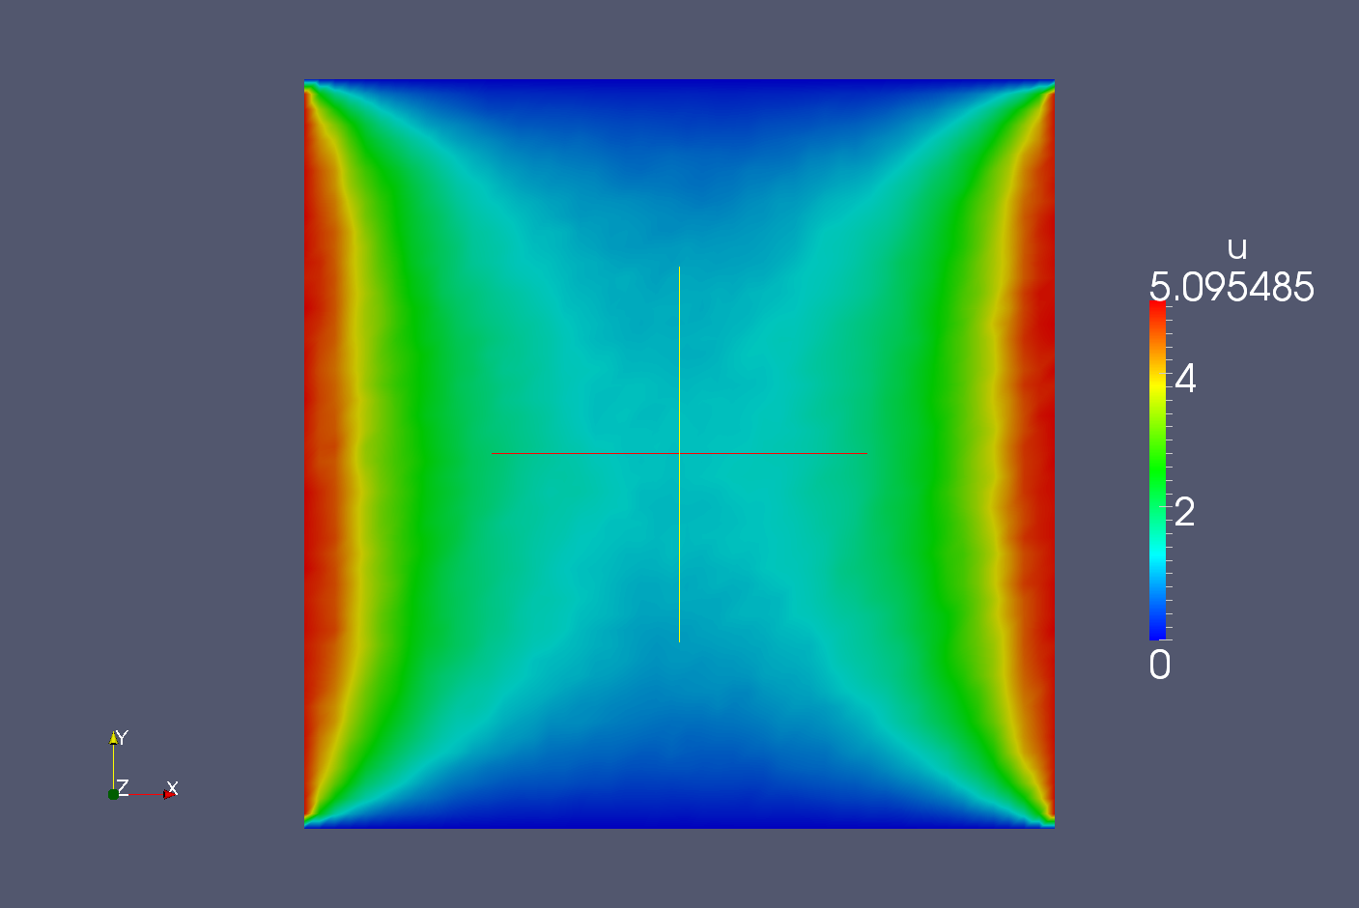
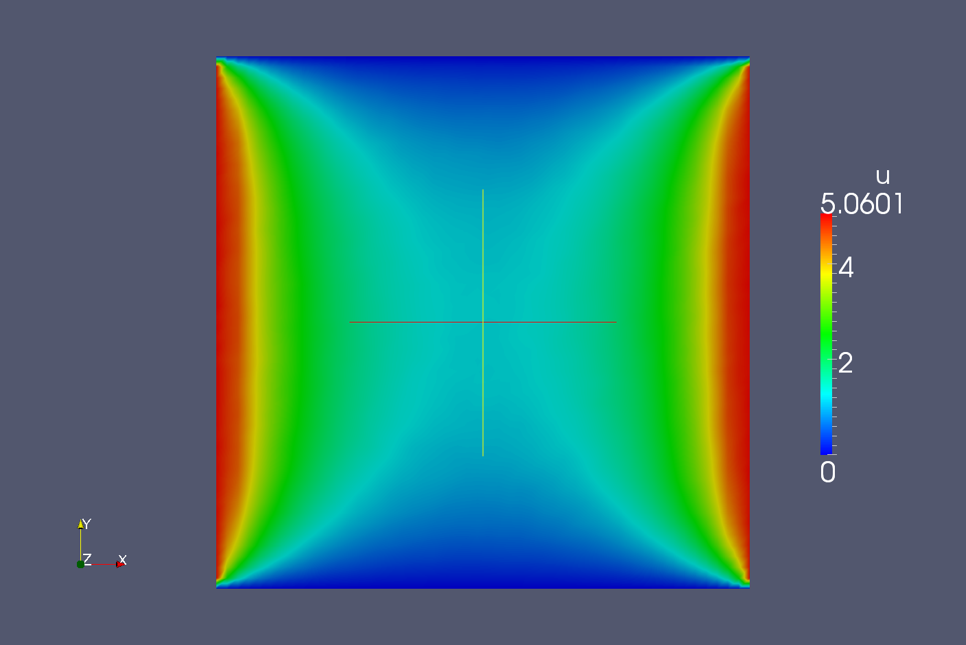
Monte Carlo Convergence
1 history
10 histories
10,000,000 histories
100 histories
10,000 histories
1,000 histories
1,000,000 histories
100,000 histories
T=0.0
T=5.0
T=5.0
T=0.0
Poisson Problem with Uniform Source of 1.0

Slide 15
Sequential Monte Carlo
Both the direct and adjoint methods converge slowly and are plagued by statistical noise.
The Sequential Monte Carlo method of Halton allows for faster convergence because it is a residual method and therefore is not constrained by the Central Limit Theorem.

Slide 16
Synthetic Schemes
Finished in 1 iteration
We can create a new iteration scheme by approximating A.

Slide 17
A Monte Carlo Synthetic Scheme (MCSA)
We define a Synthetic Scheme using Sequential Monte Carlo:
The adjoint or direct Monte Carlo method is used to estimate the correction, .
The stopping criteria for the iteration sequence is

Slide 18
Preconditioned MCSA
In order to achieve convergence (spectral radius < 1), preconditioning will, in general, be required.
The general preconditioned MCSA algorithm is:

Slide 19
Comparison of Direct vs Adjoint MCSA
To compare the direct and adjoint MCSA methods, we analyzed the time-dependent Poisson problem,
using backwards-Euler time discretization with both second-order and fourth-order spatial stencils on uniform grids.
Each time-step MCSA is used to solve the following linear system

Slide 20
Iterations and CPU Time
CPU Time to convergence versus problem size
Iterations to convergence versus problem size
Problem size N indicates a N×N square mesh.
Weight cutoff set to 1×10⁻⁴ and convergence set to 1×10⁻⁸.
N×N random walks computed for both the direct and adjoint solvers

Slide 21
Convergence of direct and adjoint methods
Constant size problem, N = 500.

Slide 22
Observations
The adjoint method is more efficient by all measurements, time, iterations, and convergence.
The direct method will always require a minimum of N×N histories because each walk only contributes to its starting component.
The adjoint method samples the starting component based on the magnitude of the residual
More histories are started where the error is large, leading to reduced uncertainty
All histories contribute to the state in which they currently reside meaning a single history contributes to multiple components of the solution

Slide 23
Sequential MC vs MCSA
MCSA output performs sequential Monte Carlo by every measure.
Recasting Sequential MC reveals that it is equivalent to a single MC preconditioned Richardson iteration.

Slide 24
Thermal Radiation Diffusion Model
The nonlinear equilibrium diffusion equation,
Use the angle-energy integrated radiation intensity as the state variable,

Slide 25
Time-Discretization
Backward-Euler time differencing,
with
Applying Fick’s Law:

Slide 26
3-D Spatial Discretization
On a 3-D orthogonal mesh standard Finite-Volume differencing is applied,
Ensuring continuity of flux at cell faces gives face-centered diffusion coefficients,

Slide 27
Flux Evaluation
Discretizing Fick’s Law gives the face fluxes and
The can be thought of as leakage probabilities from adjacent cells into the current cell:
The Discrete-Diffusion Method (Densmore, Evans, Urbatsch) uses this interpretation.
The diffusion operator must be an H-matrix (symmetric in/out/leakage at faces).
Prevents pre-conditioning strategies.

Slide 28
Preconditioning
For MCSA we do not require a SPD system; however, we do need the spectral radius less than 1,
This choice achieves:

Slide 29
MCSA for Time-Dependent Diffusion
The MCSA algorithm has 2 basic steps:
a fixed-point iteration (matrix-vector multiply)
an adjoint Monte Carlo solve
Where the adjoint method is run with a small number of particles and only approximates the operator.

Slide 30
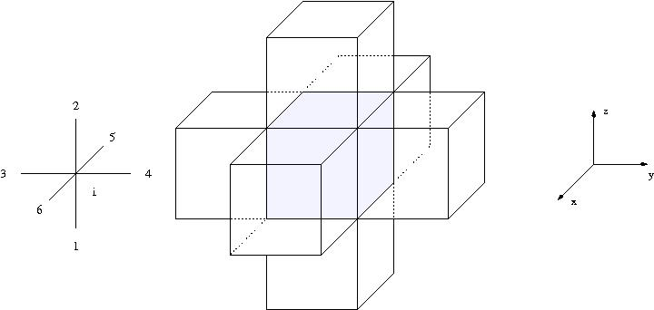
Monte Carlo Interpretation
Segment of 3D orthogonal mesh:
Each cell has six adjacent cells.

Slide 31
Monte Carlo Interpretation
The adjoint Monte Carlo solve has a natural transport interpretation:
build probabilities for scattering from cell i → n using the adjacent cell’s equations
do Monte Carlo transport through the mesh tallying in each cell,

Slide 32
MCSA Parameters
There are two control parameters when applying MCSA:
The number of particles per iteration.
The weight cutoff.
MCSA uses the same convergence criterion as standard subspace and stationary solvers, so numerical accuracy is identical between the methods (within numerical precision).

Slide 33
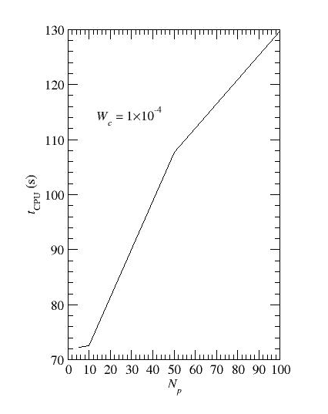
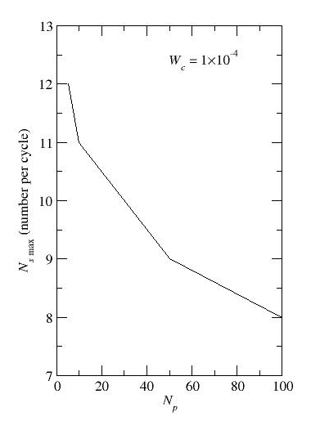
Variation with Number of Particles
Increasing particles per iteration reduces iterations at significant cost.

Slide 34
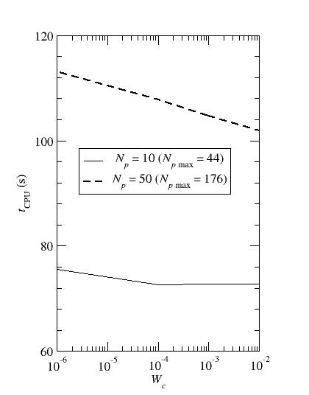
Variation with Weight Cutoff
MCSA is relatively insensitive to weight cutoff.
The source algorithm does a fit to generate the source. This can result in more source particles than requested. The maximum number of particles in any given iteration is shown in parenthesis.

Slide 35
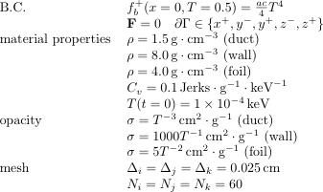
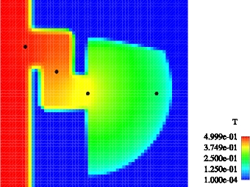
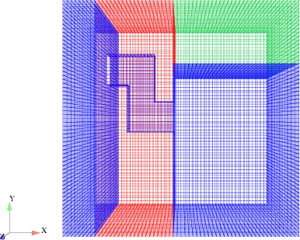
Multi-Material Duct Problem
Output at 1000 ns.

Slide 36
Comparisons with Deterministic Methods
Setting the stopping criterion to 1x10⁻⁸ for all methods we have
MCSA used 1000 particles per stage and a weight cutoff of 1x10⁻³.
Problem run to an elapsed time of 100 ns.
Method | Preconditioner | Total Iterations | Average Iterations | Relative Time per Iteration | Relative Runtime
CG | Jacobi | 42,881 | 4.22 | 2.93 | 1.02
CG | ML | 14,097 | 1.39 | 26.60 | 1.94
MCSA | Jacobi | 90,129 | 8.87 | 1.0 | 1.0

Slide 37
Monte Carlo Linear Solvers Library (MCLS)
Developed by Stuart Slattery
Designed to be easily incorporated with production physics codes
General asynchronous Multiple-Set-Overlapping-Domain (MSOD) MCSA implementation
Forward and adjoint Monte Carlo with method of expected values
Parallel row matrix/vector interface
General fixed point iteration strategy
Explicit algebraic preconditioner suite
Written in C⁺⁺
Fully implements Trilinos solver library operator (Thyra) and solver (Stratimikos) abstractions
Open source BSD 3-clause license
https://github.com/sslattery/MCLS

Slide 38
Recent Investigations
Investigated efficiency for steady-state reactor problems
Implemented into CASL Insilico SP_{N} code
Tested on CASL 17×17 3D assembly benchmark problems
Investigated efficiency for non-linear fluid flow
Implemented in Sandia’s Drekar code (fully-implicit, stabilized finite element)
Solved three Navier-Stokes benchmark problems
Thermal convection cavity problem
Lid driven cavity problem
Backward-facing step problem
Parallelization
Multiple-Set-Overlapping-Domain (MSOD) algorithm

Slide 39
SP_{N} Equations
The SP_{N} equations are implemented in CASL’s Insilico code and are used to provide global, 3D, low-order transport solutions
Applying second-order, finite-volume differencing and grouping linear combinations of flux moments:

Slide 40
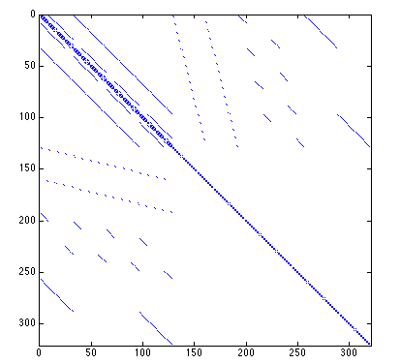
k-Eigenvalue Solution with MCSA
Power Iteration MCSA Scheme
Inject MCSA as the solver at each eigenvalue iterations
Transport operator is static – one time cost for MCSA setup
Current Insilico implementation gives the full operator

Slide 41
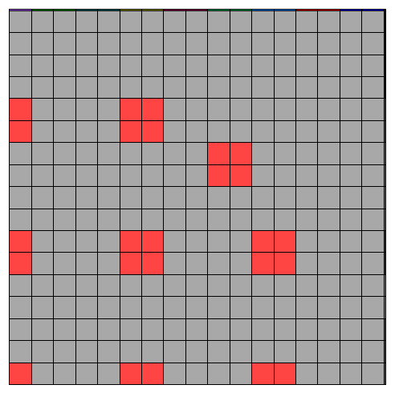
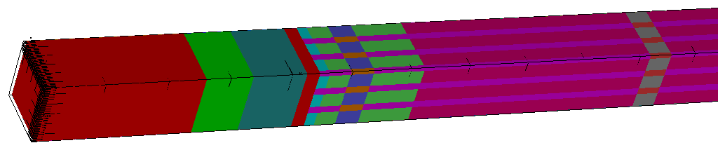
Fuel Assembly Criticality Calculations
CASL Problem 3: 17×17 quarter symmetry HZP LWR fuel assembly
Multigroup SP_{N} discretization
MCLS integrated in CASL Insilico code
Emphasize iterative performance

Slide 42
MCSA Breakdown
As things get complicated in a hurry
Number of histories to converge within 100 iterations grows dramatically after 0.97
Below 0.97, all methods converge using 1 history per DOF
At 0.998 50 histories per DOF are required
Robust preconditioners are required for SP_{N} problems

Slide 43
Fuel Assembly Results
Solver | Average linear solver iterations per eigenvalue iteration
BiCGStab-ILUT | 12.4
GMRES-ILUT | 18.9
MCSA-ILUT-R | 16.8
MCSA-ILUT-MR | 17.5
Richardson-ILUT | 63.4
Comparisons to Trilinos Aztec Krylov solvers with ILUT
MCLS verified for the k-eigenvalue and neutron flux in all groups
MCSA converged in fewer iterations than GMRES, more than BiCGStab
Explicit preconditioning strategy destroys sparsity and elevates CPU times
Spectral radius and memory limitations combine to prevent solutions at finer discretizations
Results for 4-group SPN solve

Slide 44
Multiple-Set Overlapping Domain (MSOD) Decomposition
MSOD construction
MSOD tally reduction
Multiple sets replicate the domain
Domains overlap within a set
Each set contains the full domain

Slide 45
Leadership Class Parallel Scaling Studies
Simple 2D neutron diffusion problem for control – spectral radius is maintained as global problem size grows
Comparison to Trilinos Belos Krylov solvers with Jacobi preconditioning
Strong scaling – Global size fixed at 1.6×10⁷ DOF
Weak scaling – Local size fixed at 4×10⁴ DOF
Calculations performed on Titan Cray XK7 at ORNL

Slide 46
Strong Scaling Results
Wall time
Absolute efficiency
MCLS is an order of magnitude slower arithmetically
Super-linear speed-up from memory thrashing in base case
CG demonstrates poor scaling due to the cheaper iteration sequence

Slide 47
Weak Scaling Results
Wall time
Absolute efficiency
Spectral radius maintained by growing the global boundary
MCSA maintained constant number of iterations
Krylov iteration count reduced as a function problem size

Slide 48
Strong Scaling Results with Multiple Sets
Splitting: same global number of histories as the single set
Replicating: set-multiple of single set problem global histories
Wall time
Absolute efficiency: relative to 16-core 1-set base case

Slide 49
Weak Scaling with Multiple Sets
Wall time
Absolute efficiency: relative to 16-core 1-set base case
Adding sets is a hybrid strong/weak scaling exercise
N/P is not preserved as sets are added, N/SP is held constant
Superposition of Monte Carlo results enhances time to solution

Slide 50
Summary of parallel results
MCSA scales favorably compared to production Krylov methods for both strong and weak scaling cases
Multiple sets offers a means to reduce time to solution by solving multiple copies of the original problem and combining the solutions using superposition
MCSA is most efficiently used in parallel as a stochastic realization of an additive Schwarz method
Investigating this now

Slide 51
Conclusions and Future Work
Shortcomings observed on real problems
Significant optimization required to determine production feasibility and true scalability
Explicit algebraic preconditioning methods not sufficient
Spectral radius limitation is severe
Preconditioning improvements
Variance reduction based strategy
Reduced order physics/PDE models for acceleration
Performance improvements
Random walk optimizations
Multiple set reduction analysis

